Slide 1



Weekly Meeting 3
Liri Chen, Shuo Liu, Wenqi Sun, Zhexin Wang, Zixiao Zhang

Slide 2
Milestone
Time | Milestone
Oct 3 - Oct 17 | Baseline, metrics
Oct 18 - Oct 31 | OCR optimization
Nov 1 - Nov 21 | Prototype & demo(Search w/o GPT + WebApp)
Nov 22 - Nov 28 | Backend API & UI design
Nov 29 - Dec 16 | Final Presentation

Slide 3
Progress
Image Retrieval
Baseline model
100% Acc for images
Caption Retrieval
Consider a similarity model
Table Retrieval
Baseline model

Slide 4
Metrics
Image Retrieval
Accuracy = n_extracted / n_total
Caption-Image matching (Caption retrieval)
BLEU
Jaccard Similarity
Table Retrieval
Cell-level accuracy
Row and Column Level Accuracy

Slide 5
Plans next week
Labeling data
Baseline for caption retrieval

Slide 6

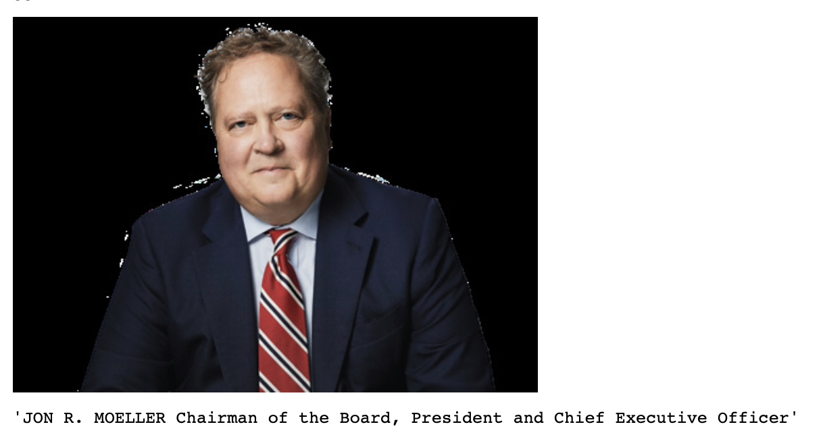
Image + Captions Retrieval
Approach:
Identify the position of image and text on a page
Search for text within a certain vertical distance

Slide 7
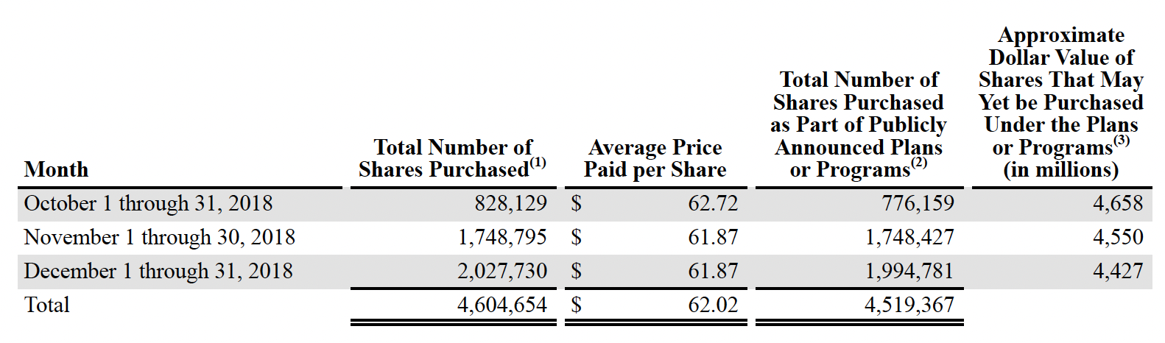
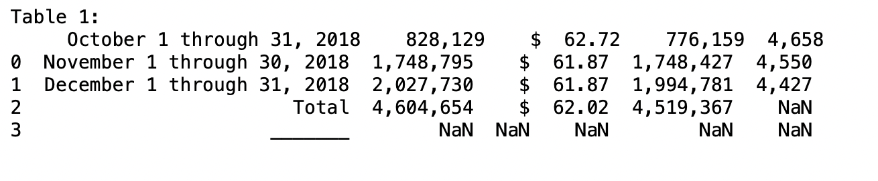
Table Retrieval
Use PyPDF, Tabula to directly extract tables from pdf.

Slide 8
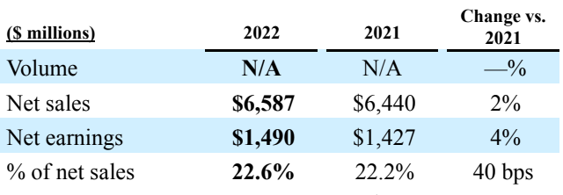
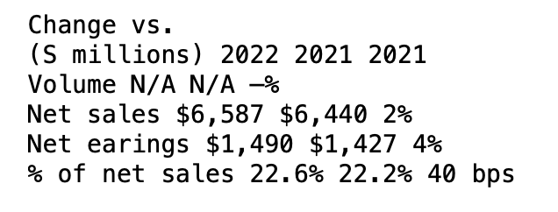
Table Retrieval
Sample from Unilever annual report - 2022
Output:
Row Level Accuracy: 100%
Column Level Accuracy: 100%
Cell Level Accuracy: 100%

Slide 9
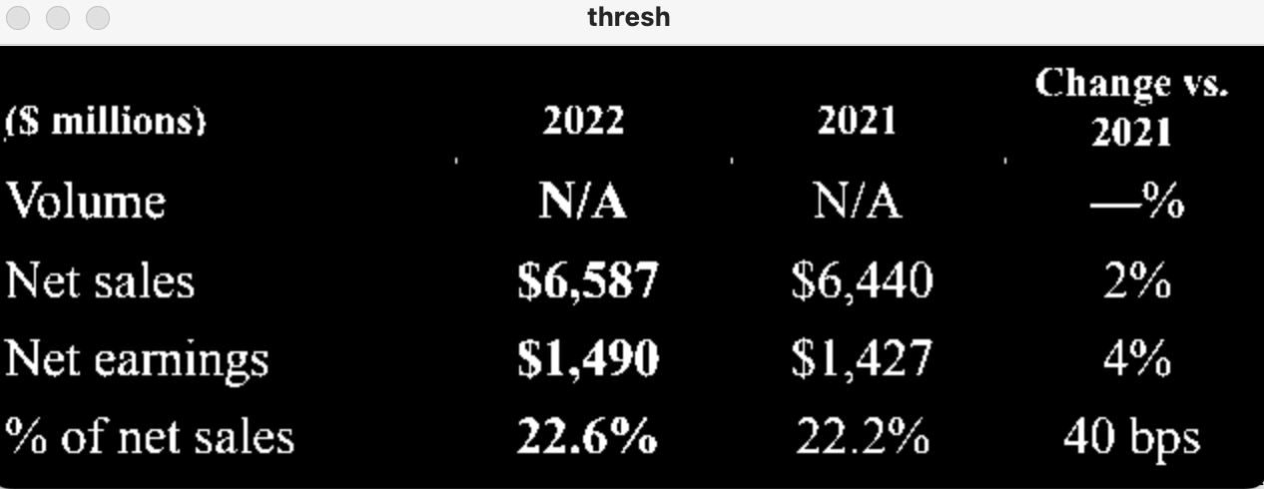

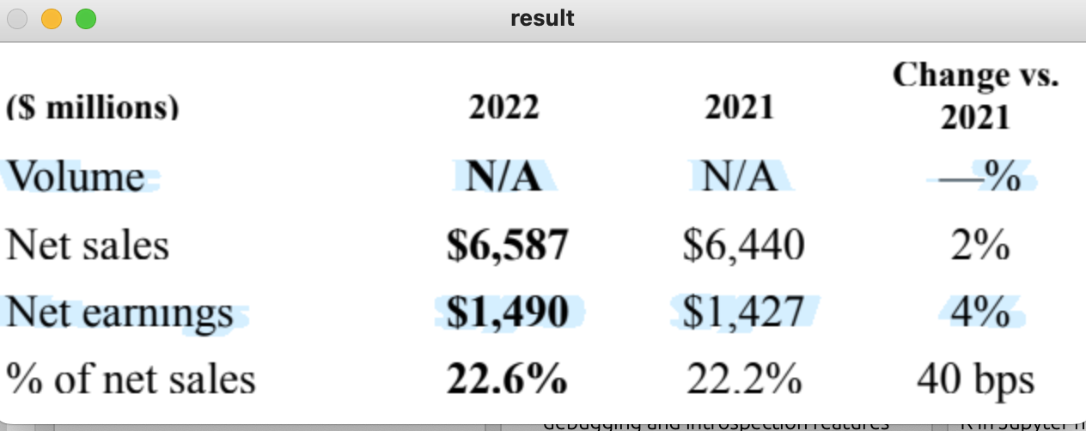
Table Retrieval Process
Load image, grayscale, and Otsu's threshold
Remove horizontal lines
Remove vertical lines
Dilate to connect text and remove dots
OCR - Print data

Slide 10
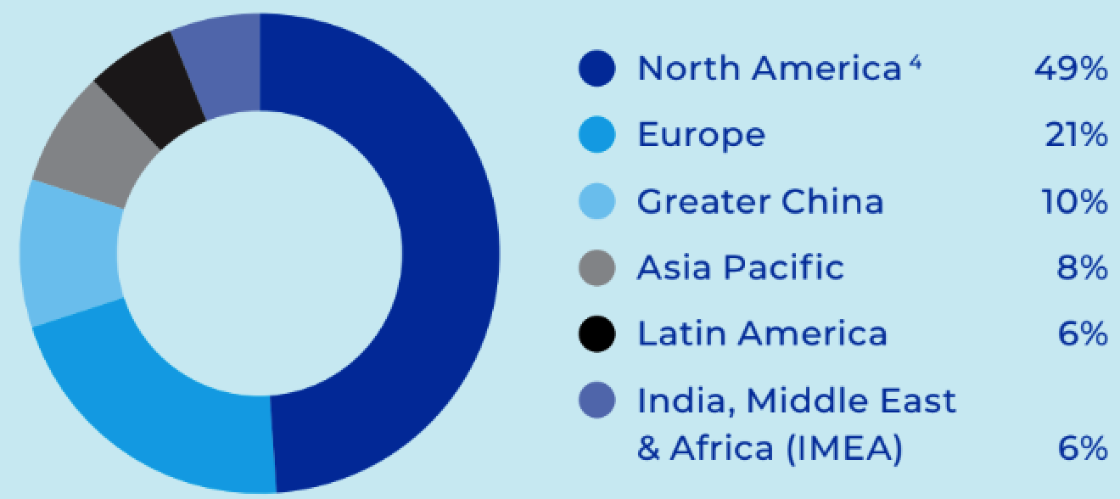
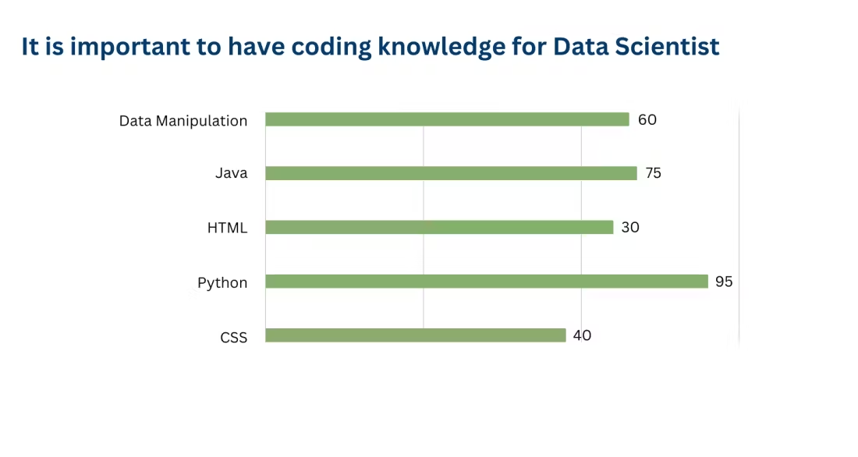
Target-driven Approach for OCR on Graphs
pie-chart-ocr
[(0.06, 'Latin America'), (0.1, 'Greater China'), (0.49, 'North America'), (0.06, 'India, Middle East Africa (IMEA'), (0.21, 'Europe'), (0.08, 'Asia Pacific')]
https://git.ehtec.co/research/pie-chart-ocr
bar-plot-ocr
{'header': ['It is important to have coding knowledge for Data Scientist'],
'Mapping': {'Data Manipulation': '60',
'Java': '75',
'HTML': '30',
'Python': '95'}}
https://blog.futuresmart.ai/extracting-data-from-charts-and-graphs-the-ocr-challenge-solution
Notes:
Pros: most open source, easy to deploy (hand-written), have good result on similar-structurized graph
Cons: limited to the given target, \may have trouble to be customized to a new layouts, redundant codebase, not encapsulated in an industrial manner.
This is not bad since it would be good to unbox the black box of NN and figure out the principle of how these works do OCR is good for further implementation.

Slide 11
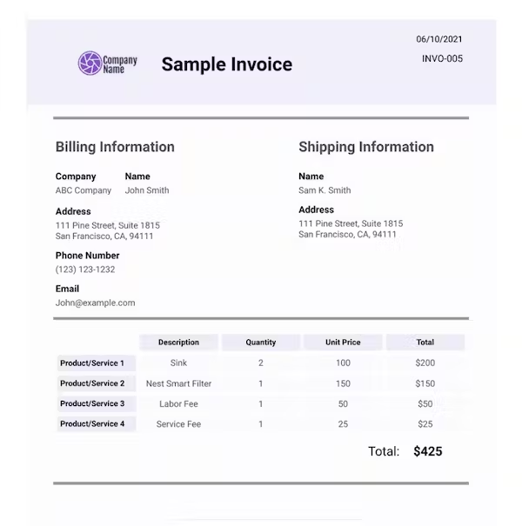
GPT-based OCR on Graphs
A Motivating Example (Invoice)
Pseudo
For file_name in dir:
Open file
Preliminary OCR using Azure formrecognizer
Tell GPT her system role (a specific prompt)
Provide her with a example entities (output format)
Get response from GPT
Save GPT’s answer
Draw a new plot
https://blog.futuresmart.ai/invoice-processing-with-azure-ocr-and-gpt-4-an-in-depth-step-by-step-guide
Notes:
Pros: Highly-embedded and able to deal with more complex structure of graphs (target-drived is limited to specific structure, cannot deal with two pie plot on the same image or with other structured titles), contain the intelligence of NL sequences (like the disorder of terms I mention last week), also able to handle table, convenient to do the following task like draw a new plot or generate a table
Cons: Slow when extracting images from a branch, hard to test their accuracy, no reproducible (gpt’s answers are diff), need a predefined format for i/o put
This method may also based on existing OCR research or tools, but GPT is a black box, not sure how they developed. So the following interns may hard to optimize this module. GPT determines the upper limit of this function.

Slide 12
GPT-based OCR on Graphs
Results
Company Name: Company ABC
Billing Information:
Name: John Smith
Address: 111 Pine street, Suite 1815
City: San Francisco
State: CA
Zip Code: 94111
Phone Number: (123) 123-1232
Email: John@example.com
Invoice Date: 06/10/2021
Invoice Number: INVO-005
Shipping Information:
Name: Sam K. Smith
Address: 111 Pine Street, suite 1815
City: San Francisco
State: CA
Zip Code: 94111
Product/Service 1:
Description: Sink
Unit Price: 100
Total: $200
Product/Service 2:
Description: Nest Smart Filter
Unit Price: 150
Total: $150
Product/Service 3:
Description: Labor Fee
Unit Price: 50
Total: $50
Product/Service 4:
Description: Service Fee 2
Unit Price: 25
Total: $25
Total: $425
Notes:
In which case, user need what kind of images?
Do we really need to extract images and their captions together?
Do we need to process charts?

Slide 13
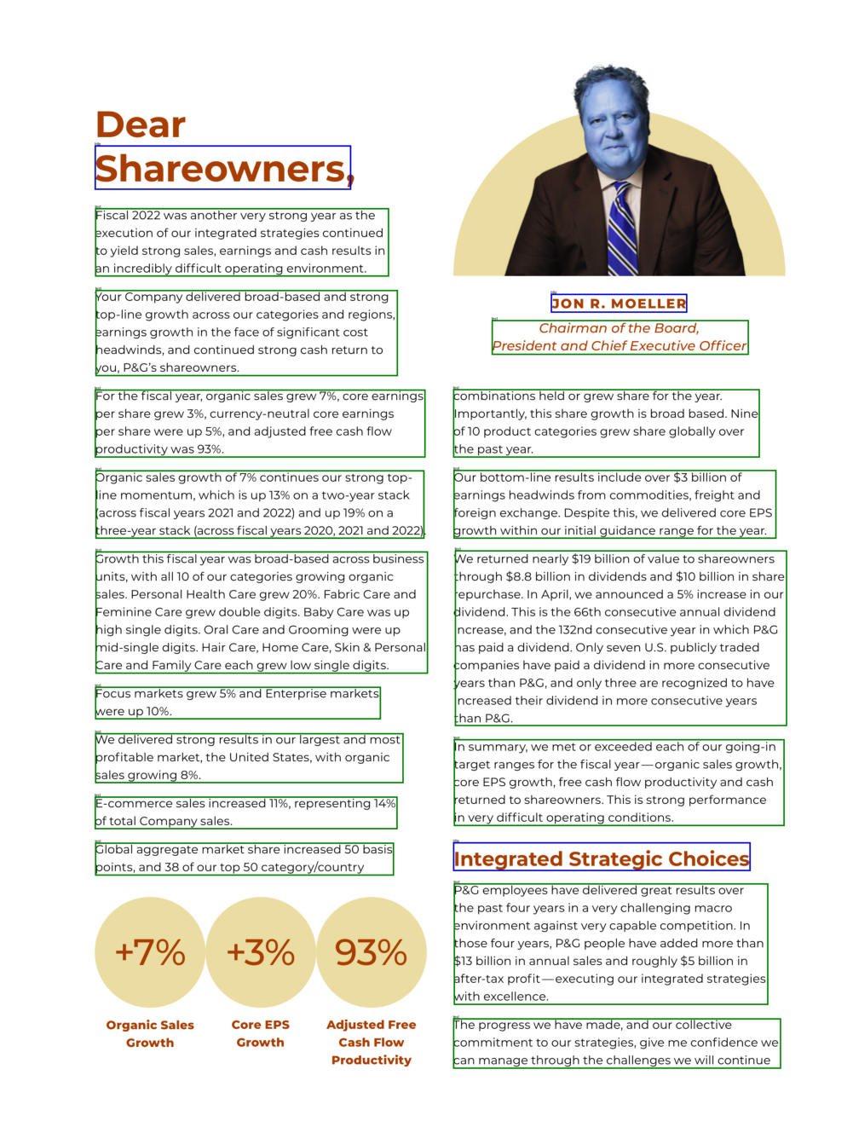
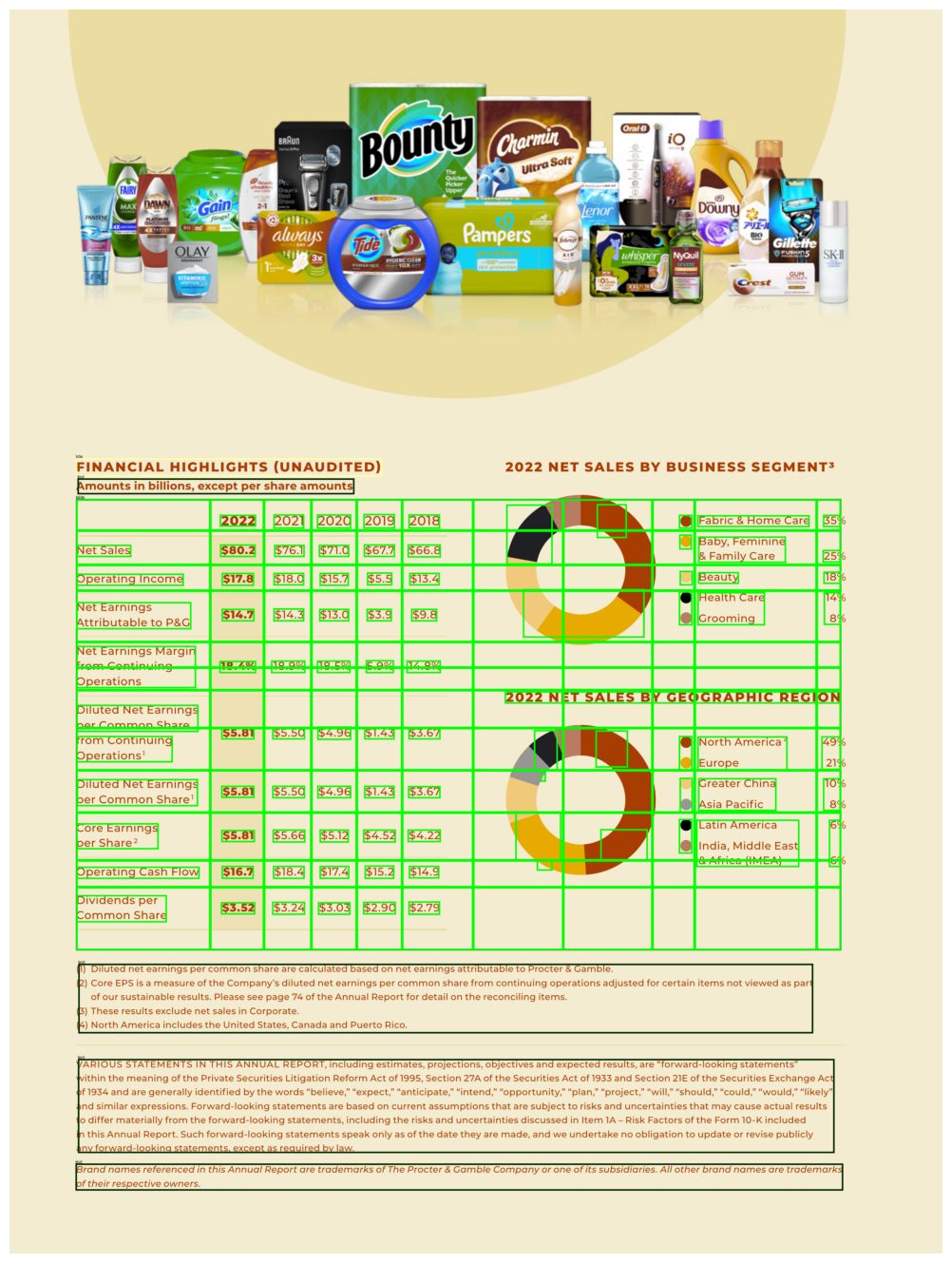
Deepdoctection result(sample)

